Slide 1
Writing the College Essay
Notes:
First Ask them to write down one thing they would like their parent or guardian to know they are going through in this process and on other side one thing that person could do to help. Then talk briefly about the parts of a college application – most important thing is the transcript, then recs, activities, essays, etc. Transcript gets at the following;
Grades in College Prep (Core) Classes
Strength of Curriculum
Standardized Test Scores
Grades in all Classes
We are going to talk about the story beyond the transcript: the next most important things:
Essay or Writing Sample - 26%
Class Rank/distribution – 23%
Demonstrated Interest – 22%
Counselor Recommendation - 21%
Teacher Recommendation - 21%
Interview -11%
Subject Tests (SAT II, AP, IB ) – 6.5%
Extracurricular activities – 6.5%
State Graduation Exams – 4 %
Work – 2 %

Slide 2
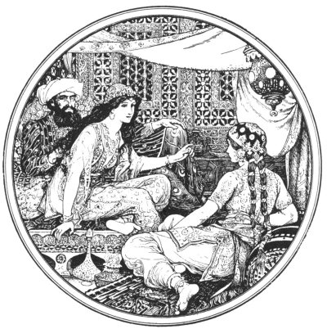
The Best Essays
“Answer the question honestly.”
“…show who you are not simply what you’ve done.”
“Tell a story only you could possibly tell.”
“…take me out of my office for five minutes.”
“…give me an interior monologue.”
Tell me a Story, Scheherazade
Notes:
Scheherazade - Persian storyteller who prevented the king from killing any more women be telling him a story that ended at dawn – he kept her alive to finish the story the next night. Stories capture us and take us away. “Our” story helps others understand how we experience the world – perceptions, emotions, ethics, etc. They show don’t tell…

Slide 3
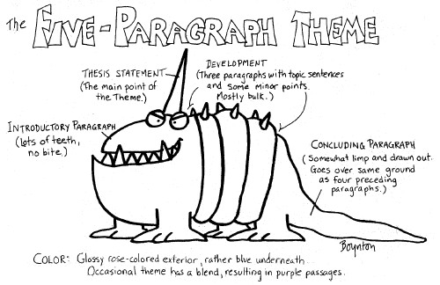
The Best Essays Don’t
“… write what you think others want to hear.
“… give me a travelogue.”
“… tell me about the action; they tell me your reaction to it.”
Ask “What does the admission committee want to read?”
And Finally…..
“The goal line (…or homerun or whatever) means nothing to me. I want to know how you got there.”
Notes:
For the most part – you’ve been writing analytical/academic essays and it can be hard to go back and write personal narrative again. For some tips - listen to your little brother or sister tell a story about something that happened to them that day – they have not lost their sense of story.

Slide 4
http://thisibelieve.org
Notes:
From the website:
Tell a story about you:
Be specific. Take your belief out of the ether and ground it in the events that have shaped your core values. Consider moments when belief was formed or tested or changed. Think of your own experience, work, and family, and tell of the things you know that no one else does. Your story need not be heart-warming or gut-wrenching—it can even be funny—but it should be real. Make sure your story ties to the essence of your daily life philosophy and the shaping of your beliefs.
Be brief: Your statement should be between 500 and 600 words. That’s about three minutes when read aloud at your natural pace.
Name your belief: If you can’t name it in a sentence or two, your essay might not be about belief. Also, rather than writing a list, consider focusing on one core belief.
Be positive: Write about what you do believe, not what you don’t believe. Avoid statements of religious dogma, preaching, or editorializing.
Be personal: Make your essay about you; speak in the first person. Avoid speaking in the editorial “we.” Tell a story from your own life; this is not an opinion piece about social ideals. Write in words and phrases that are comfortable for you to speak. We recommend you read your essay aloud to yourself several times, and each time edit it and simplify it until you find the words, tone, and story that truly echo your belief and the way you speak.

Slide 5
CA Essay Instructions
- The essay demonstrates your ability to write clearly and concisely on a selected topic and helps you distinguish yourself in your own voice.
- What do you want the readers of your application to know about you apart from courses, grades, and test scores?
- Choose the option that best helps you answer that question and write an essay of no more than 650 words, using the prompt to inspire and structure your response.
- Remember: 650 words is your limit, not your goal. Use the full range if you need it, but don't feel obligated to do so. (The application won't accept a response shorter than 250 words.)
Notes:
Admissions officers can tell if a 50 year old woman wrote your essay or you did. If you don’t use billion dollar words regularly, don’t do it in your essay.
Your essay can tell the story of an item that you listed in the “activities” section, but it shouldn’t be a rehashing of the entire section.
3) Remember, the Gettysburg Address, President Lincoln’s famous speech that began with the words “four score and seven years ago”? It was given in the middle of the civil war (at the dedication of a cemetery) to remind people that the war was was being fought to uphold the ideals put forth by the founding “fathers” vision that all “men” were created equal. One of the most powerful and influential speeches in the history of America and it was less than 300 words –about two minutes long….!

Slide 6
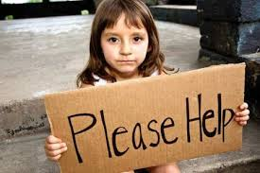
Some students have a background, identity, interest, or talent that is so meaningful they believe their application would be incomplete without it. If this sounds like you, then please share your story.
Notes:
http://thisibelieve.org/essay/31840/
This is your story – not a story about your grandma or your friend – rather that person’s impact on you.
If your life has been filled with challenges that you have managed and overcome and that now lend you strength in your journey to your future
Playing the violin makes me lonely.

Slide 7
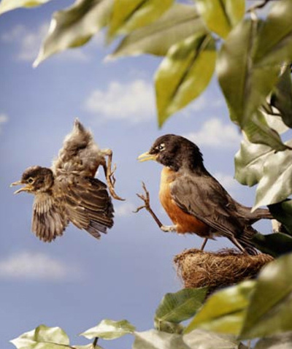
The lessons we take from failure can be fundamental to later success. Recount an incident or time when you experienced failure. How did it affect you, and what did you learn from the experience?
Notes:
Pretty much universally agreed that in order to achieve success, people need to experience and cope with failure – the issue is your response – what you did next? Not the place to talk about unresolved issues – eating disorders, etc. unless they have been dealt with and truly are that which has made you stronger.
Great place to use humor ….if you are funny. If you are not – don’t!

Slide 8
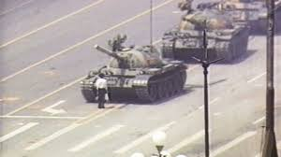
Reflect on a time when you challenged a belief or idea. What prompted you to act? Would you make the same decision again?
Notes:
http://thisibelieve.org/essays/age/under18/page/2/
Could be very small or very big….”That’s so gay” in the popular vernacular at school. Perhaps family believes one way and you decide another way. Church?

Slide 9
Describe a problem you've solved or a problem you'd like to solve. It can be an intellectual challenge, a research query, an ethical dilemma-anything that is of personal importance, no matter the scale. Explain its significance to you and what steps you took or could be taken to identify a solution.
Notes:
Intellectual challenge/Research query – your capstone project – if it really lit a fire under you and got you to think about something in a new way.
Some ethical dilemnas that you’ve encountered?

Slide 10
Discuss an accomplishment or event, formal or informal, that marked your transition from childhood to adulthood within your culture, community, or family.
Notes:
Think about this as the moment everything changed. Try to crystalize it to a single moment when what you knew afterward was something you did not know before.

Slide 11
Supplemental Essays
Notes:
Do your research – college mission statement, departmental web pages, athletics and activities, friends who go there, school newspaper, what you remember the rep saying when they visited your school or what you saw when you were there.

Slide 12
College Specific Supplements
Imagine you have to wear a costume for a year of your life. What would you pick and why?” (Brandeis University)
“What is your favorite ride at the amusement park? How does this reflect your approach to life?” (Emory University)
“What does Play-Doh have to do with Plato?” (University of Chicago)
“Why did you do it?” (Wake Forest University)
“You have 150 words. Take a risk.” (University of Notre Dame)
“Gadget that needs inventing (in 20 words)” (University of North Carolina)
“Write a haiku, limerick, or short poem that best represents you.” (NYU) “How did you get caught? (Or not caught, as the case may be.)” (Chicago) “Are we alone?” (Tufts)
“You have just completed your 300-page autobiography. Submit Page 217. (UPenn)”

Slide 13
…and don’t use “rice”
Rice University
Notes:
Avoid cliché’s – the time you didn’t get to play in the big game, but still felt like part of the team, etc.
Or did volunteer work somewhere and realized that poor people could be happy….etc.

Slide 14
Important Tips
Always write in first person.
“I….Me….My….Mine” etc.
Avoid use of editorial first person plural.
“We…us…our…ours” etc.
Never Use the word “you.”
Unless you are using it in a direct quote:
My dad said, “You must become a dentist.”
Notes:
This is an essay only you can write.
1st person plural sounds preachy and generalizes
“You” – just don’t.
Read the essay aloud to someone who knows you well.

Slide 15
REMEMBER
Most Important Factors in College Admissions:
Grades in College Prep (Core) Classes
Strength of Curriculum
Standardized Test Scores
Grades in all Classes
Stuck? Talk to Your School Counselor. She or he is there to help.
Notes:
Once you have this – the rest is icing on the cake – the stuff that sets you apart - recs

